Slide 1

Application of abuse of tax law in the Czech Republic
Jirina Prochazkova
Expert Symposium on Tax Law, Bratislava, 21 January 2025
Notes:
For additional images check out deloitte legal brandspace https://brandspace.deloitte.com/content/index/guid/custom_identity_imagery?parent=1619&list_size=96&assettag[1493][]=1497

Slide 2
"Legal certainty must be balanced with other values of the legal system. Tax law should not become a kind of legal 'Wild West,' where practically every type of opportunistic behavior must be tolerated as long as it is in accordance with a strict formalist interpretation of the relevant tax provisions and the legislator has not explicitly taken measures to prevent such behavior.“
(GA Maduro in the Halifax case, para. 77)

Slide 3
Application of the concept of abuse of law in CZ
Abuse of law is an unwritten general principle of law applicable more, or less across all areas of Czech law
National tax law
The national concept was defined by the Supreme Administrative Court in its case law
    E. g. judgment of November 10, 2005, file no. 1 Afs 107/2004-48 (case “divers”)
As of 1 April 2019, abuse of law included in Czech Tax Code
    “In the tax administration, no account shall be taken of legal actions and other facts relevant to the administration of taxes, if the predominant purpose of which is to obtain a tax advantage contrary to the meaning and purpose of the tax legislation” (Sec. 8 para. 4)
    2 conditions – objective condition (despite the formal fulfilment of the requirements of the law, its purpose and meaning have not been fulfilled), subjective condition (the main or predominant purpose of the tax subject's actions was to obtain a tax advantage)

Slide 4
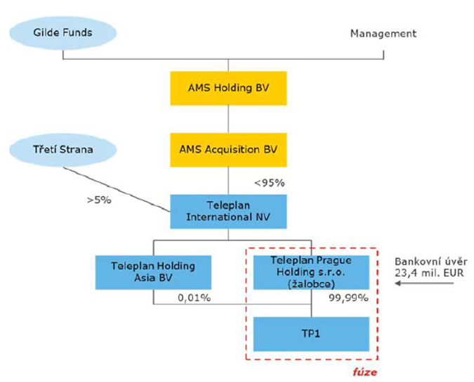
Case law on abuse of law I. – tax deductibility of interest from acquisition financing
Judgment of the Supreme Administrative Court, file No. 8 Afs 246/2022 – 61, dated 25 June 2024
The Supreme Administrative Court confirmed the economic justification of the merger with debt pushdown to the operating entity, subjective condition was NOT met, it is NOT abuse of law.
The transactions were made based on the explicit request of the lending bank for the debt to be pushed down to the operating entity.
Such a request from the lending bank is economically rational, as the obligation from the loan can be directly serviced from the revenues or assets of the operating entity.
X different conclusion in the judgment of the Supreme Administrative Court č. j. 5 Afs 195/2022 – 61

Slide 5
Case law on abuse of law II. - tax treatment of profit distribution from a limited liability company to holding - judgment of the Supreme Administrative Court, file No. 10 Afs 16/2023 – 78, dated 23 July 2024
Tax Authorities claimed it IS an abuse of law
The holding is tax-driven, does not perform activities, and began acquisition activities only after 4 years.
They could have first distributed the profit and from that paid the outgoing partner
X
The Court concluded that it is NOT abuse of law
confirmed that the objective condition was met, but not the subjective one
X different conclusion - ZexeZ (file No. 6 Afs 376/2018, dated 14 November 2019)
Purchase price for business share
HOLDING
Profit
1
2
Bank loan

Slide 6
Lessons learned and questions for discussion
Signature features of abuse of law in Czech application practice
    transactions between related parties, holdings in jurisdictions like Cyprus, speed of transactions, rather internal reasons for the transactions at stake
Cases of abuse of law are cases of moral impression
    Is it permissible in public law and what about legal certainty of taxpayers?
It is applied in grey zones, not only in black one
    How is that compatible with notion that abuse of law should be applied as a last resort?
    What does it mean – if the predominant purpose is to get tax advantage? If the transaction has no other explanation than taxes?

Slide 7

Thank you for your attention!
KONTAKT
Jiřina Procházková
Partner| Advokátka
Deloitte Legal s.r.o., advokátní kancelář
T: +420 777 293 481
E: jprochazkova@deloitteCE.com
Deloitte Legal s.r.o., advokátní kancelář
Sídlo: Italská 2581/67, 120 00 Praha 2
Tel.: +420 246 042 500
www.deloittelegal.cz

