Slide 1
ABUSE OF TAX LAW
Case law on crown bonds
Bratislava, 21.01.2025
JUDr. Patrik Koželuha, Ph.D.

Slide 2
4 Afs 376/2021
303.626.000 CZK
KOH-I-NOOR HARDTMUTH a.s.
550.000.000 CZK
Decrease of
registered capital
GAMA GROUP a.s.
KOH-I-NOOR holding a.s.
100% share
Subscription
of bonds
Subscription
of bonds
Loan
120M CZK
Loan
45M CZK
Loan
45M CZK
share
share
share
A
B
C
Shareholders

Slide 3
7 Afs 175/2022
Bozadziev s.r.o.
incorporation: 1. 2. 2012
decision on issue of bonds (10M CZK): 19.11.2012
executives = shareholders
Agreement on transfer of business enterprise
for 11,5M CZK
Subscription of bonds
Subscription of bonds
Increase of the registered capital with 2,3M CZK
share
share
shareholder
MUDr. I.B.
shareholder
MUDr. Z.B.
spouses

Slide 4
Potential topics for discussion
1. The boundaries between the taxpayer's right to choose the most economically advantageous option and the boundaries between situations that can be assessed as an abuse of law
2. Consequences of the conclusion on the abuse of law for an individual case (complete disregard for transactions vs. finding a balanced solution)
3. The question of punishment in the level of criminal law - can the abuse of law be criminal?

Slide 5
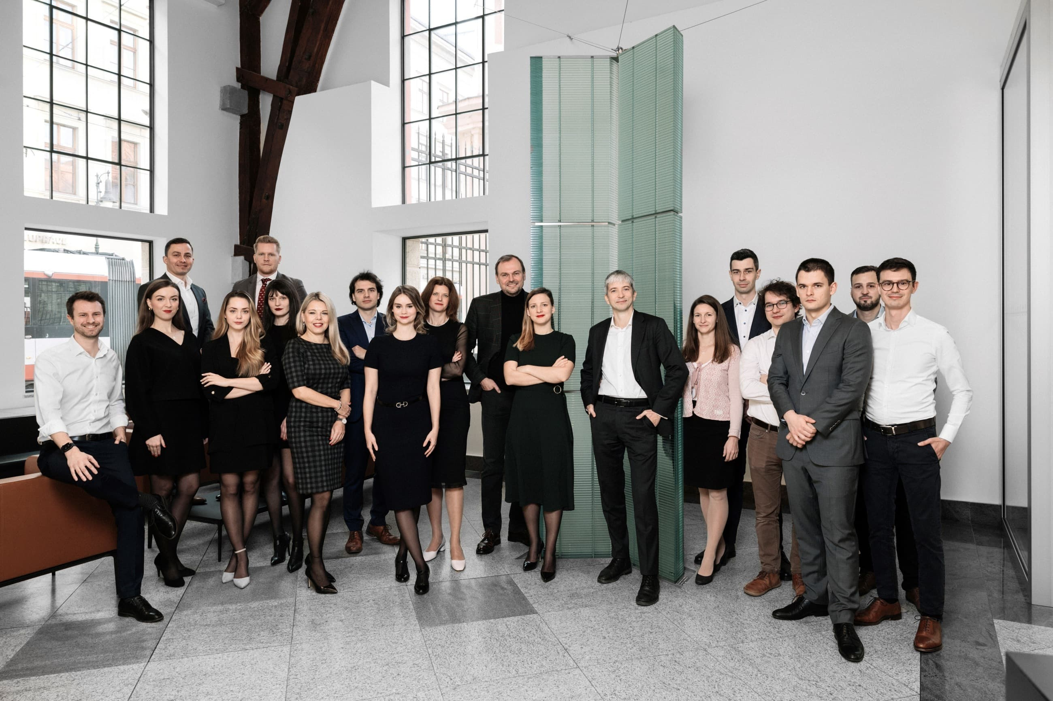
Na Poříčí 1079/3a, 110 00 Praha 1
+ 420 777 601 114 | info@brizatrubac.cz | www.brizatrubac.cz

